Slide 1
Home Loan Defaults
Prediction Methods - Neural Networks

Slide 2
Contents / Agenda
Business Problem Overview & Solution Approach
Data Dictionary
Exploratory Data Analysis (EDA) Results
Data Preprocessing
Model Performance Summary
Best Model Selection
Conclusions & Recommendations
Appendix / Screenshots

Slide 3
Data Dictionary
The data contains different attributes of customers’ loan and credit details. The detailed data dictionary is given below:
BAD: Whether the client defaulted on the loan (0 = No, 1 = Yes)
LOAN: Amount of loan approved
MORTDUE: Amount due on the existing mortgage
VALUE: Current value of the property
REASON: Reason for the loan request (HomeImp = Home Improvement, DebtCon = Debt Consolidation)
JOB: Type of job the applicant has (e.g., Manager, Self-employed)
YOJ: Years at present job

Slide 4
Data Dictionary
DEROG: Number of major derogatory reports (serious delinquency/late payments)
DELINQ: Number of delinquent credit lines (past due payments)
CLAGE: Age of the oldest credit line in months
NINQ: Number of recent credit inquiries
CLNO: Number of existing credit lines
DEBTINC: Debt-to-income ratio (all monthly debt payments divided by gross monthly income)

Slide 5
Business Problem Overview
Consumer Home Loans represent a substantial percentage of retail bank profits. Loan defaults (NPA – bad loans) can put those profits at risk. It is in a banks best interest to thoroughly vet perspective loan applicants to minimize loan default occurrences.
Loan Underwriting is a multi-phase process involving:
Credit Analysis/Assessment – credit scores, history, existing debt, DTI ratio
Employment/Income Verification employment status/history, income confirmation
Asset Assessment – verification of down payment, investments, properties, liquid assets
Collateral Evaluation – property appraisal, loan-to-value (LTV) ratio, title search
Risk Assessment – borrower profile, red flags, risk rating

Slide 6
Business Problem Overview
Verification Process the existing process is a manual one with a lot of hands-on human interactions.
The current process is characterized by:
Human-dependent
Labor/Resource-intensive
Time-consuming
Manual / manually-driven
Paper-heavy / document-heavy
Prone to human error / inconsistency
Subjective (underwriter discretion varies)
Difficult to scale

Slide 7
Business Problem Overview
Limitations of the current approach include:
Effort-intensive
Clerical errors
Data/document errors
Prone to errors in judgment
Prone to incorrect approvals
Susceptible to human error
Vulnerable to bias
Documentation/reasoning concistency
Bottlenecks, long turn around times – reduces potential for scalibility

Slide 8
Project Goals and Objectives
Goal:
A bank's consumer credit department seeks to streamline the decision-making process for home equity lines of credit. In compliance with the Equal Credit Opportunity Act (ECOA), the department requires an empirically derived and statistically sound credit scoring model.
The model will be developed using data collected through the existing loan underwriting process from recent applicants who were granted credit. The model needs to be interpretable to provide reasonings for loan acceptances/rejections.
Objective:
Build a classification model using an Artificial Neural Network (ANN) to predict clients who are likely to default on loans. The model should provide recommendations on the key features to consider during loan approval.

Slide 9
Solution Approach
1. Exploratory Data Analysis (EDA)
Perform general Exploratory Data Analysis (EDA)
Perform supplementary EDA on charts rendered through Rapid Miner.
2. Perform Follow up EDA after Feature Engineering
Assuming that Feature Engineering was provided for the project:
Repeat EDA and supplementary EDA analysis of preprocessed (normalized) data
3. Basic Neural Network (NN) Analysis
Analyze initial Model performance results
4. Neural Network with Parameter Tuning
Hand Tune selected NN parameters and rerun the model (iteratively)
Comment on parameter tuned NN Model performance

Slide 10
Solution Approach
5. Neural Network Tuned Using Grid Search
GridSearchCV Evaluates all combinations of hyperparameters to find the best-performing configuration
Analyze hyperparameter tuned NN Model performance.
6. Model Performance Summary
Compare NN, parameter and hyperparameter tuned Model results
7. Conclusions and Recommendations
Final observations, insights and recommendations

Slide 11
Expected Outcomes
Improved revenue: Better inventory management and optimized cancellation policies
Reduced operational costs: More efficient resource allocation
Enhanced customer experience: Customized policies for different risk segments
Data-driven decision making: Actionable insights for strategic planning
Additional revenue streams: Suggest new programs and strategies to capture untapped revenue streams

Slide 12
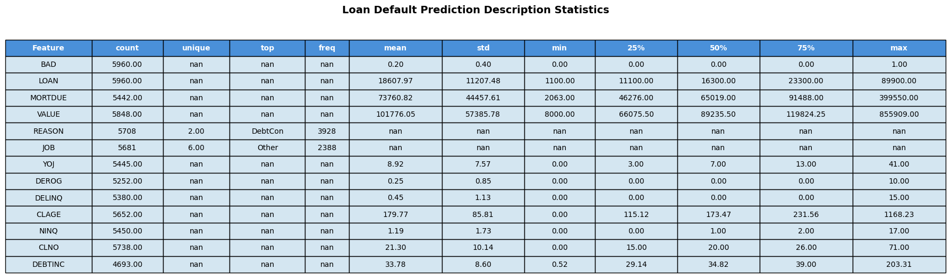
Initial Exploratory Data Analysis (EDA)
Summary statistics for features including count, mean, standard deviation, and distribution percentiles.
Missing values — There are a lot of missing values (DEBTINC has 4,693 vs 5,960 total records); imputation needed
High variance — VALUE and MORTDUE have large standard deviations (STD)relative to means
Potential outliers — CLAGE max of 1,168 months (~97 years), DEBTINC max of 203% seem extreme
Skewed distributions — Several features show large gaps between 75% and max (LOAN, VALUE, MORTDUE)
Categorical features — REASON and JOB will need encoding
DEBTINC most incomplete — Only 4,693 records; key feature for loan risk so imputation strategy matters

Slide 13
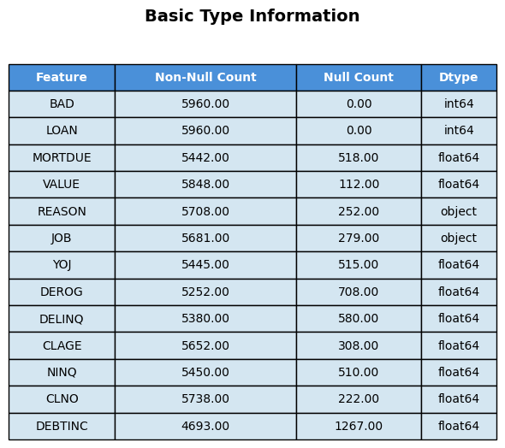
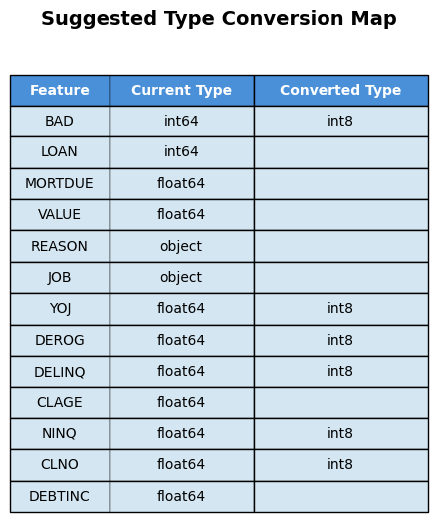
Initial Exploratory Data Analysis (EDA)
Analyze the raw data types and identify any that can be converted for better cpu performance.

Slide 14
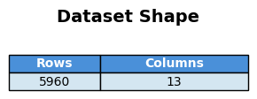
Initial Exploratory Data Analysis (EDA)
Based on the initial observations of the number of missing feature values, it’s important to note the shape of the imported data set. The dataset has 5960 rows of data. It’s important to keep that fact in mind when examining missing values and exploring imputation techniques.
The number of missing values calls into question the quality of the dataset and given the required number of imputations, how truly accurate the model performance, predictions and results will be.
It’s important to truly understand the dataset, especially if it comes from an unknown source.

Slide 15
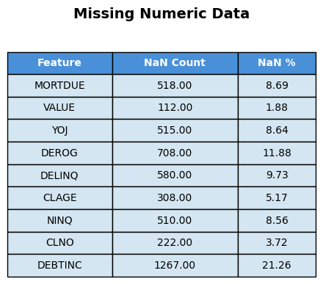
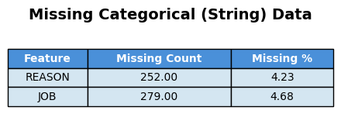
Initial Exploratory Data Analysis (EDA)
A break down of the Numeric and Categorical feature missing data counts.

Slide 16
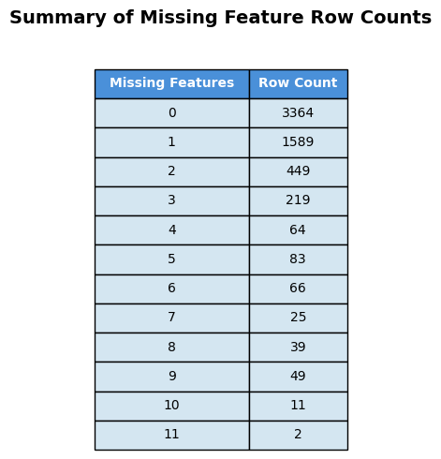
Initial Exploratory Data Analysis (EDA)
Summary table of data completeness by showing how many rows have missing values.
A lot of rows of 1 or more missing feature values. Give a data set of 5960 rows, only 3364 rows are feature complete. This once again calls into question the quality of the dataset.

Slide 17
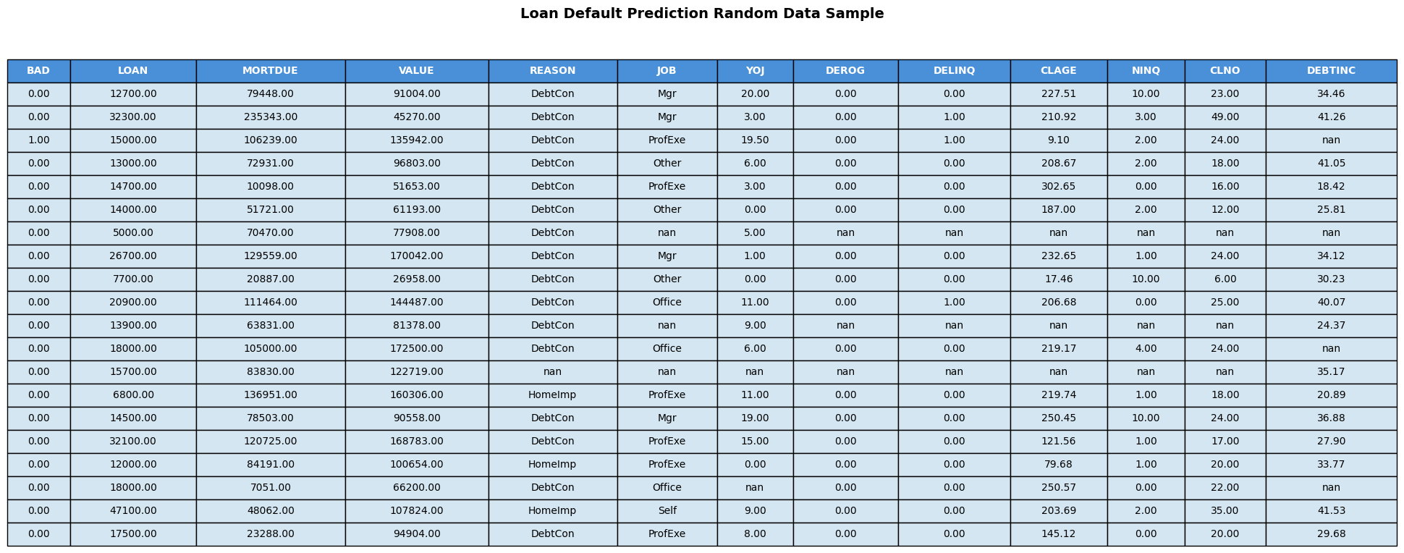
Initial Exploratory Data Analysis (EDA)
Table containing a random sampling of 20 rows from the imported raw dataset.

Slide 18
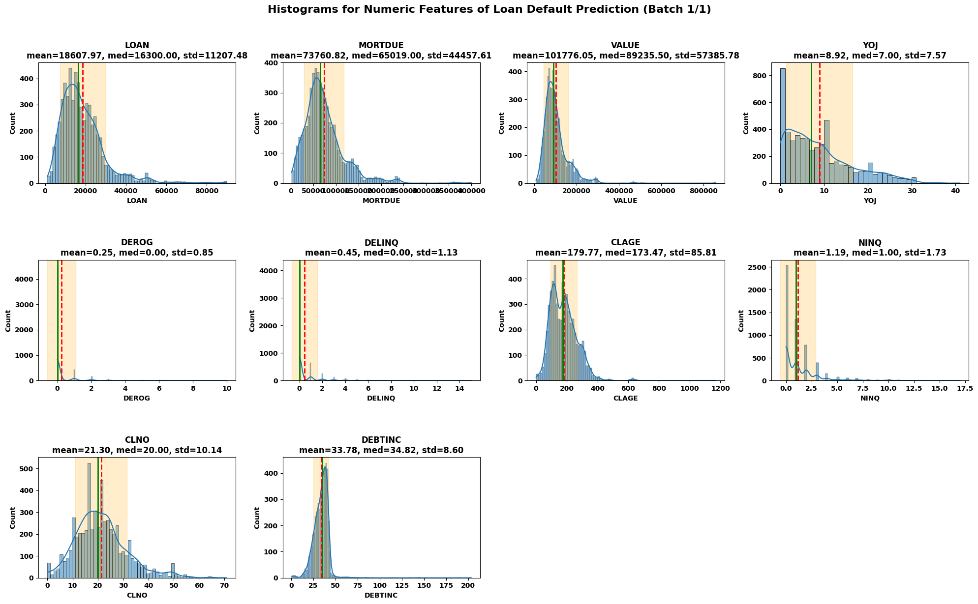
Initial Exploratory Data Analysis (EDA)

Slide 19
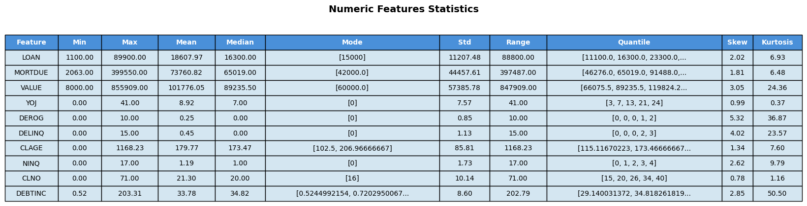
Initial Exploratory Data Analysis (EDA)
LOAN – Right-skewed, clustered around $15k, large outliers
MORTDUE – Right-skewed, clustered around $70k
VALUE – Highly Right-skewed
YOJ – Most normal distribution, mode=0
DROG – Zero inflated (most values=0)
DELINQ – Zero inflated (most values=0)
CLAGE – Relatively symmetric, extreme outliers
NINQ – Highly Right-skewed, most have 0-2 inquires
CLNO – Close to normal distribution, but still has right skew
DEBTINC – High kurtosis, extreme outliers

Slide 20
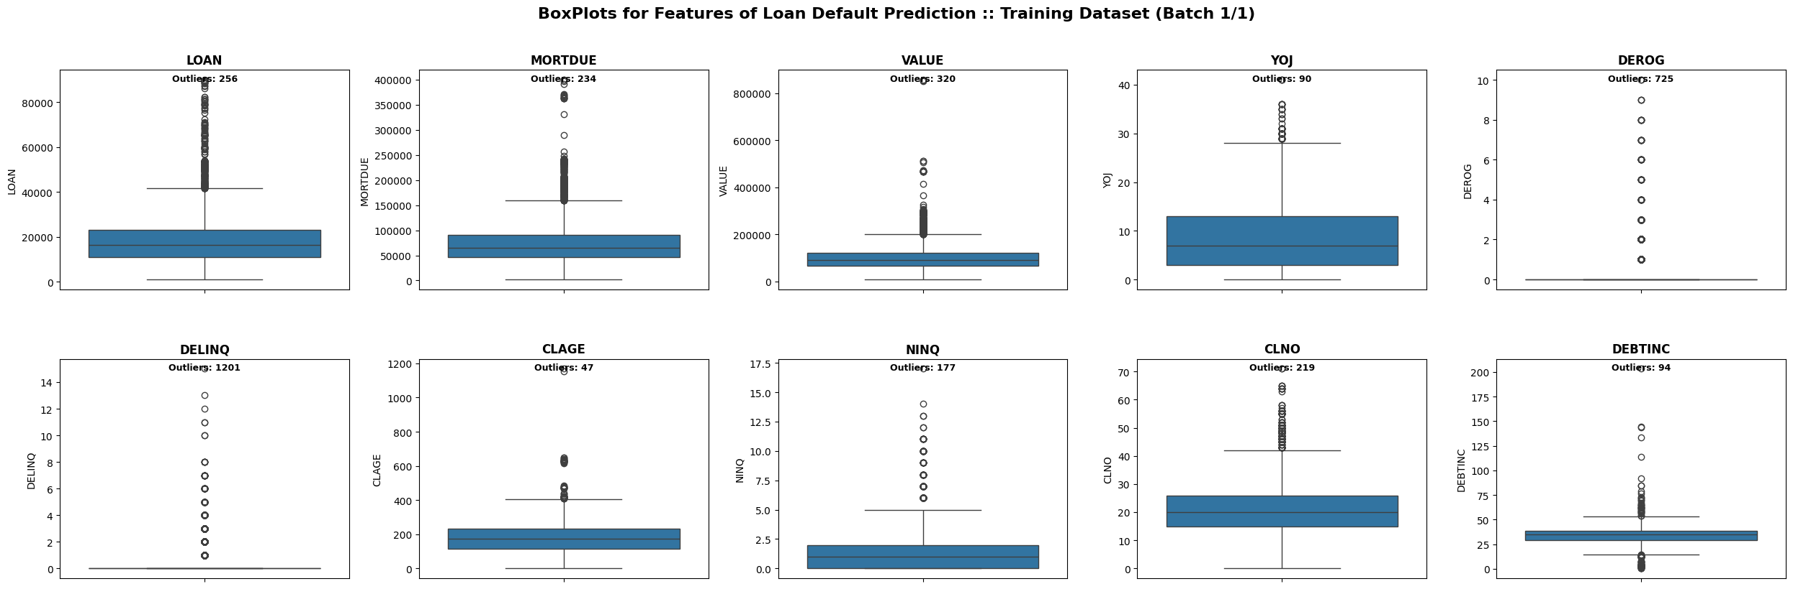
Initial Exploratory Data Analysis (EDA)
LOAN – Wide Inter Quartile Range (IQR), outliers > $40k
MORTDUE – Tight IQR, high outliers > $45k
VALUE – Tight IQR, high outliers > 200k
YOJ – Wideset IQR, still high outliers
DROG – Box collapsed at 0
DELINQ – Box collapsed at 0
CLAGE – Tight IQR, fewer outliers
NINQ – Tight IQR
CLNO – Tight IQR, high outliers
DEBTINC – Tight IQR, +/- outliers exist

Slide 21
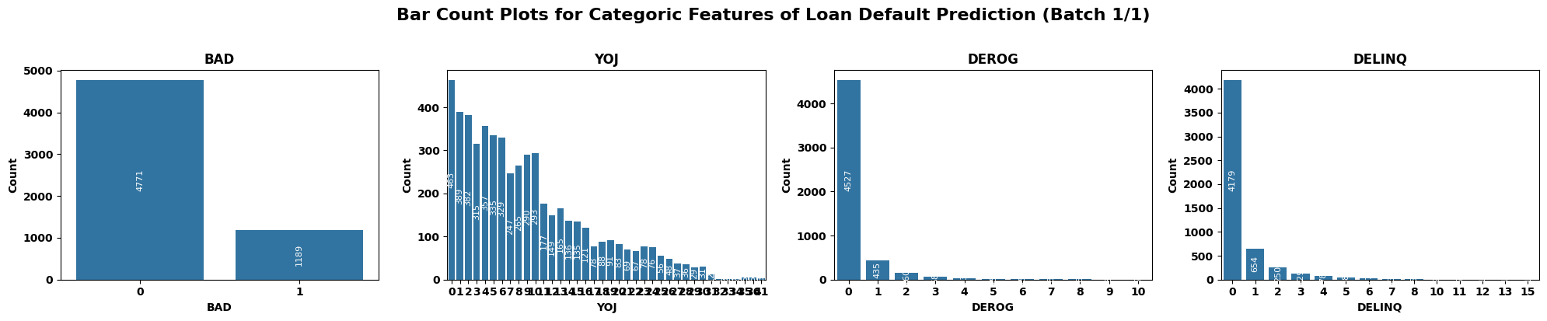
Initial Exploratory Data Analysis (EDA)
BAD – predicted feature label, class imbalance, 80% of loans don’t default
YOJ – Right-skewed, declines after 4 years
DEROG – Most values are 0 (zero-inflated)
DELINQ – Zero-inflated, Right-skewed

Slide 22
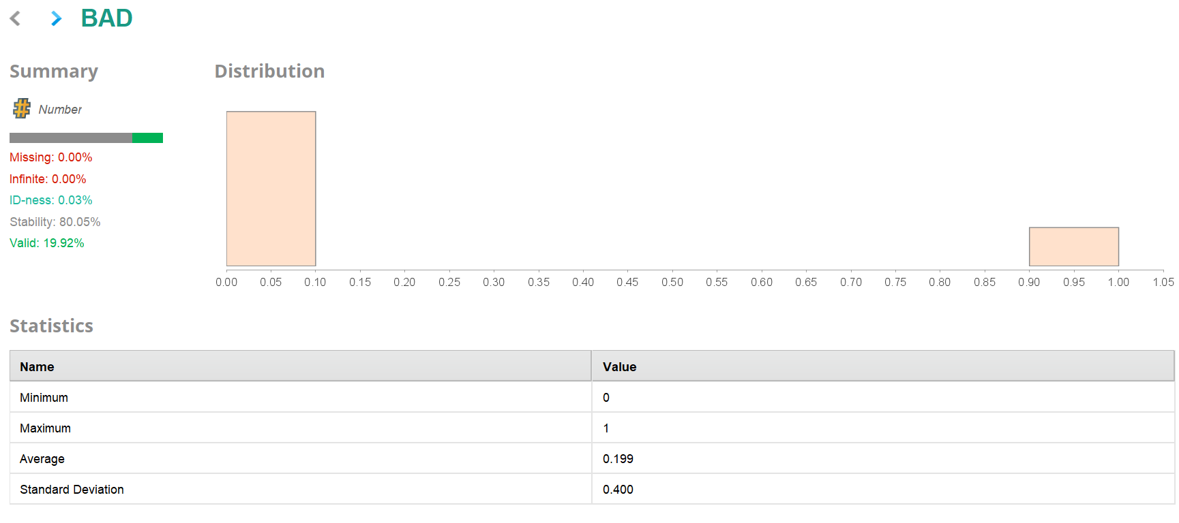
Statistics after Retrieve (Initial EDA):
At this stage, the statistics were used to understand the raw data before any modifications. This helped in identifying missing values, data types, and the overall distribution of features. It represents the initial univariate exploratory data analysis (EDA).

Slide 23
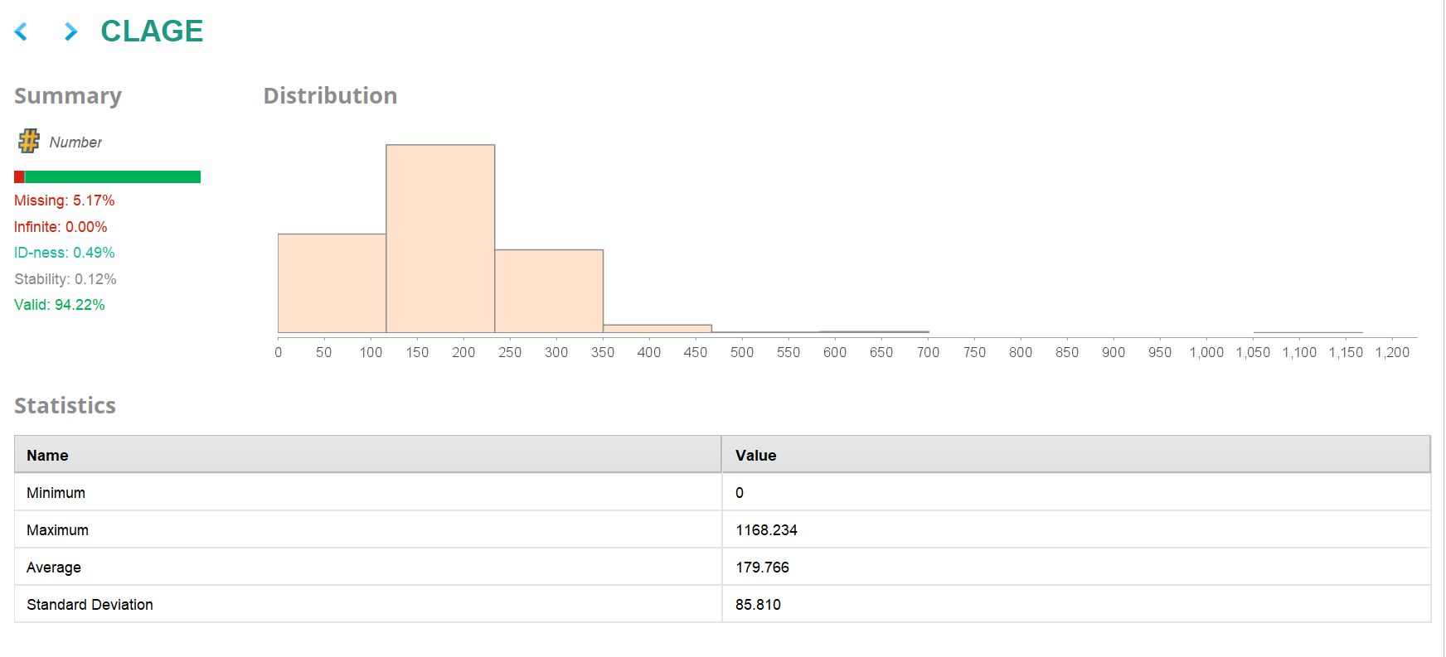

Slide 24
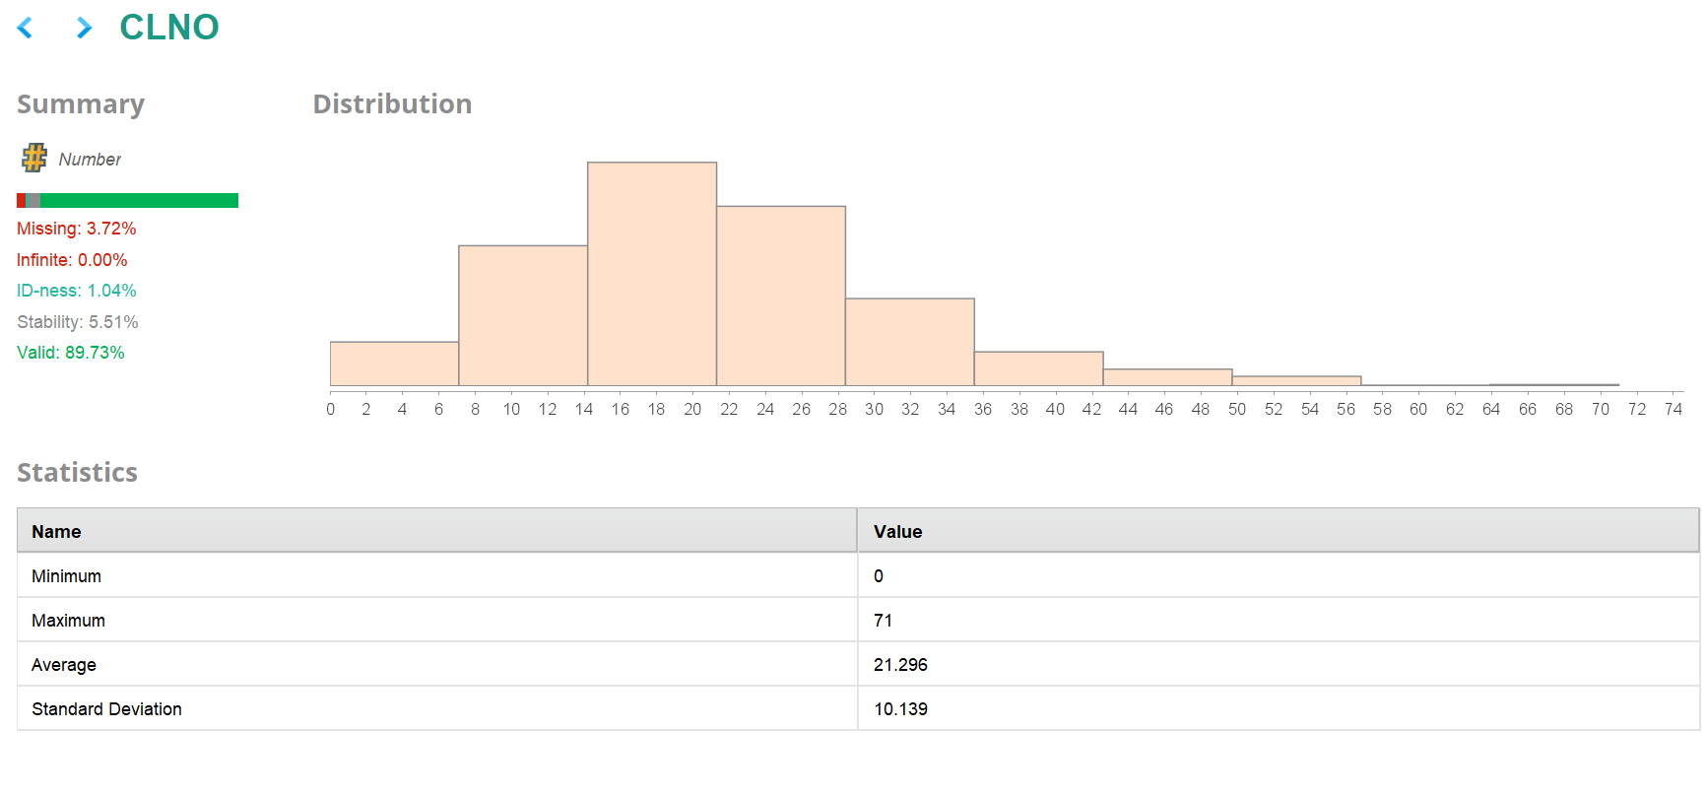

Slide 25
The Statistics give insights into different attributes of the dataset. We have shown the results for BAD, CLAGE, and CLNO to understand how these variables behave at each stage. Other attributes like DEBTINC, DELINQ, DEROG, JOB, LOAN, MORTDUE, NINQ, REASON, VALUE, and YOJ are also available in the dataset you can explore them in the same way using the Statistics operator to understand their patterns and values.
Add your insights and observations regarding the attributes you analyze in order to gain a deeper understanding of the data.

Slide 26
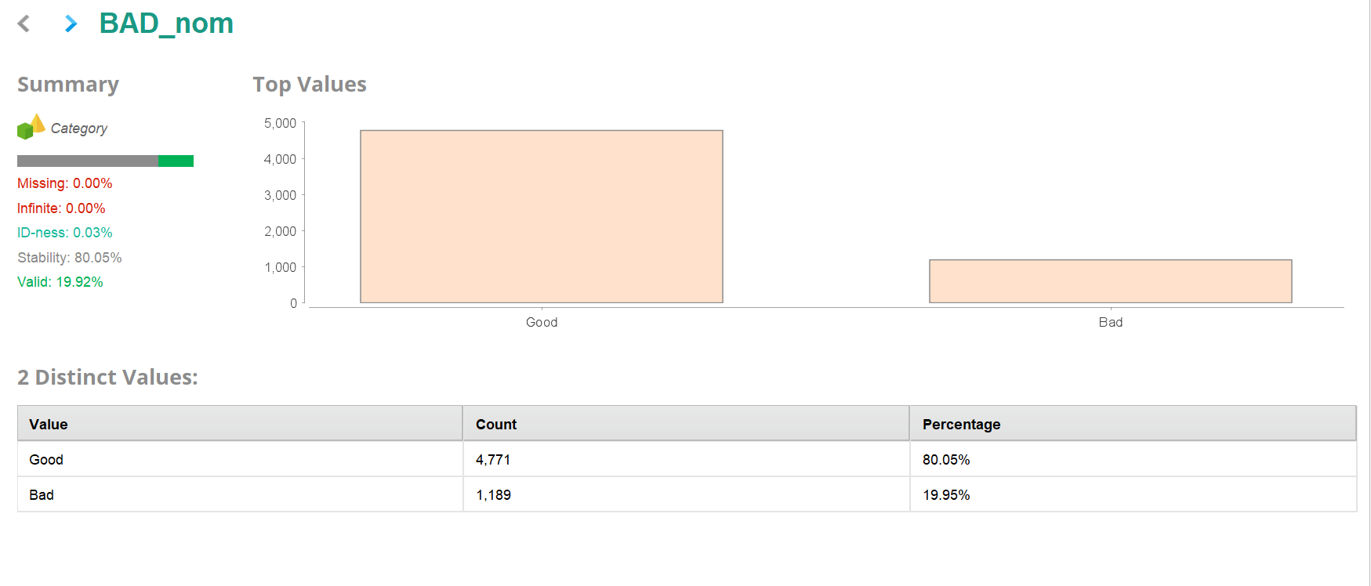
Statistics after Preprocessing:
After performing preprocessing steps such as missing value replacement, nominal-to-numerical conversion, and normalization, the statistics were again used to verify the changes and improvements. This helped confirm that data cleaning and transformations were applied correctly and that the dataset was now ready for modeling.

Slide 27
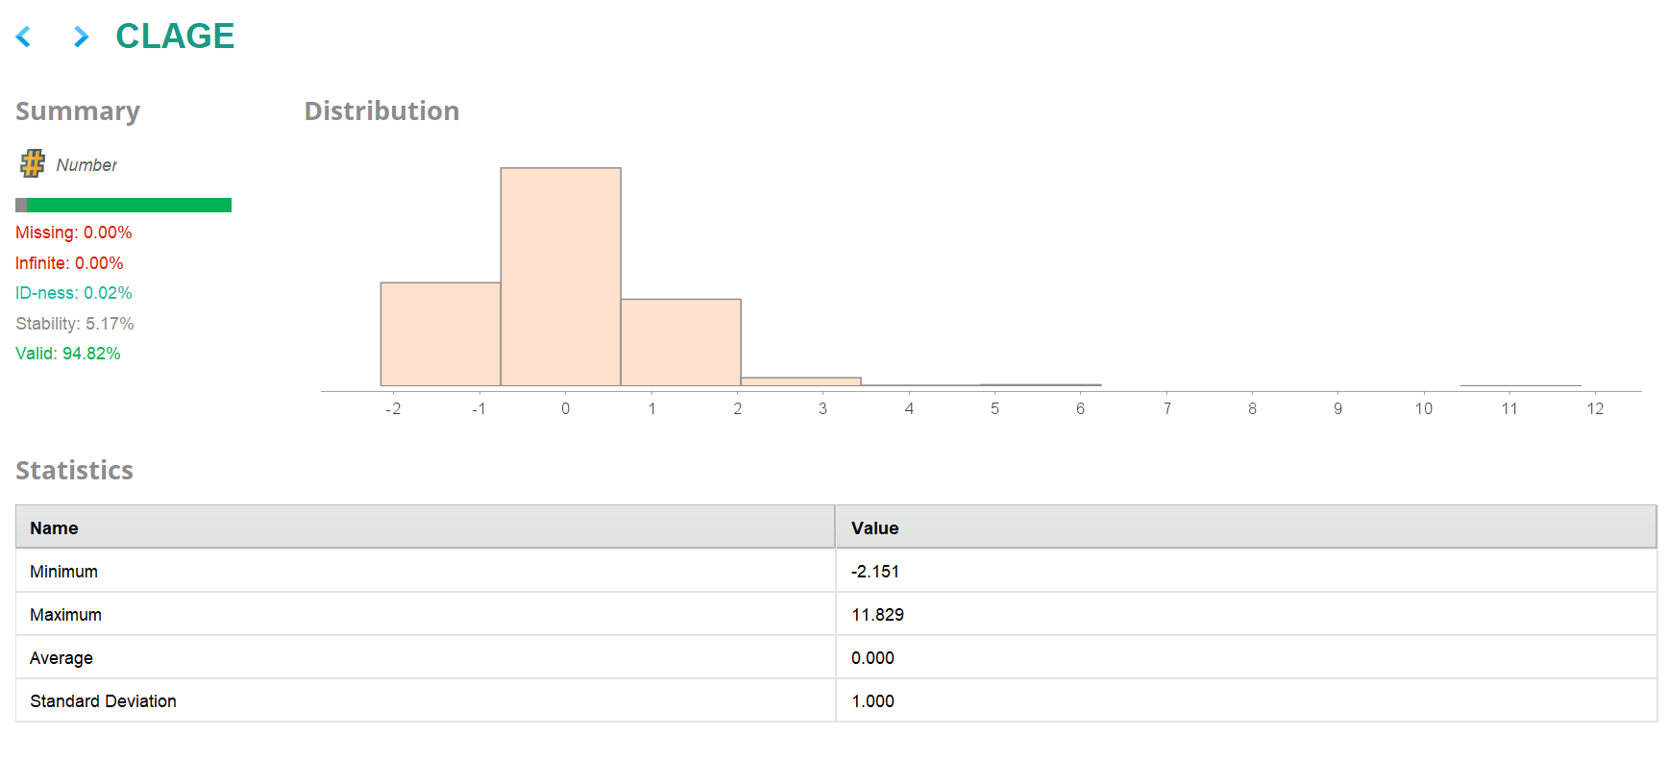

Slide 28
The Statistics give insights into different attributes of the dataset. We have shown the results for BAD_nom, CLAGE, and CLNO to understand how these variables behave after preprocessing. Other attributes like DEBTINC, DELINQ, DEROG, JOB_Mgr, JOB_Office, JOB_Other, JOB_ProfExe, JOB_Sales, JOB_Self, LOAN, MORTDUE, NINQ, REASON_DebtCon, REASON_HomeImp, VALUE, and YOJ are also available in the dataset - you can explore them in the same way using the Statistics operator to understand their patterns and values.
Add your insights and observations regarding the attributes you analyze in order to gain a deeper understanding of the data.

Slide 29
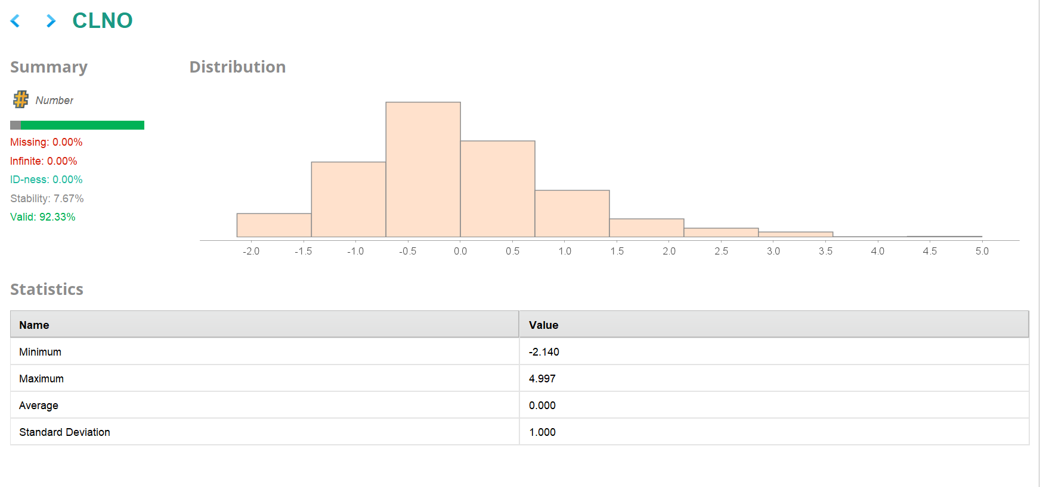

Slide 30
Scenario 1: Basic Neural Network
Please comment on the model performance
Metric | Accuracy | Kappa | Weighted Recall | Weighted Precision
Basic Neural Network | 84.96 | 0.507 | 74.20 | 76.71

Slide 31
Scenario 2: Neural Network With Parameter Tuning
Please comment on the model performance of the
Metric | Accuracy | Kappa | Weighted Recall | Weighted Precision
Neural Network with Parameter Tuning | 87.92 | 0.583 | 76.37 | 83.17

Slide 32
Scenario 3: Neural Network Using Grid Search
Please comment on the model performance
Metric | Accuracy | Kappa | Weighted Recall | Weighted Precision
Grid Search Optimized Model | 88.120 | 0.546 | 72.24 | 89.25

Slide 33
Model Performance Summary
Which model is best for predicting loan defaults, and which metric is most important to check? Why?
Which metric is most important, and why?
What advice would you give the business from this model?
Metric | Accuracy | Kappa | Weighted Recall | Weighted Precision
Without parameter tuning | 84.96 | 0.507 | 74.20 | 76.71
With parameter tuning | 87.92 | 0.583 | 76.37 | 83.17
Grid Search Optimized Model | 88.120 | 0.546 | 72.24 | 89.25

Slide 34
Conclusions and Recommendations
Please mention actionable insights & recommendations

Slide 35
APPENDIX

Slide 36
Slide Header
Please add any other pointers (if needed)

